Slide 1
265ced1609a17cf1a5979880a2ad364653895ae8
Engaging the users and
Gamifying the
experience
Kunal Narang 102003058 Amadeus Software Labs Private Ltd. India
Mentor: Madhuri Pendyala
& Manoj Kumar C A
Start Date : 08 Feb 2024
End Date : 30 June 2024

Slide 2


Slide 3

Focus on the key sections where user may feel disconnected or disengaged during his journey on the website and create solutions to solve the same

Slide 4
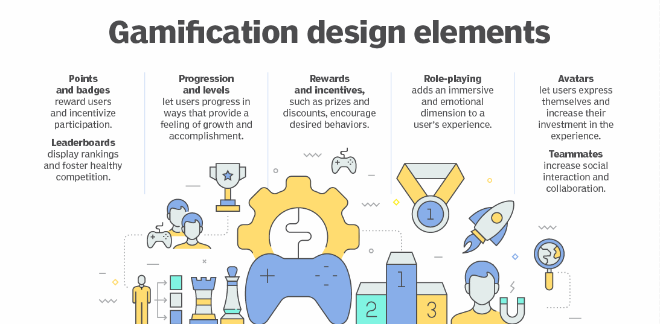

Slide 5
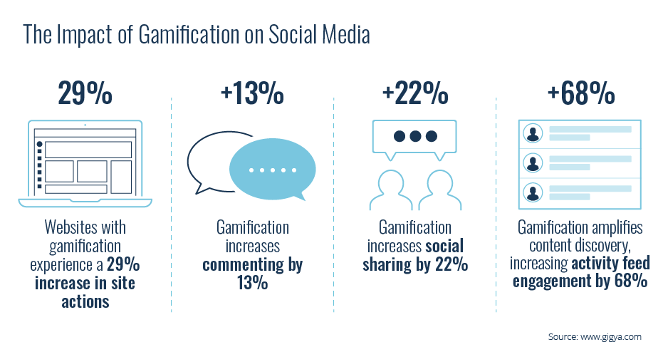

Slide 6

Roadmap
Loyalty Dashboard Travel Map
Profile Avatars
Travel Postcards
Travel destination
suggestions

Slide 7
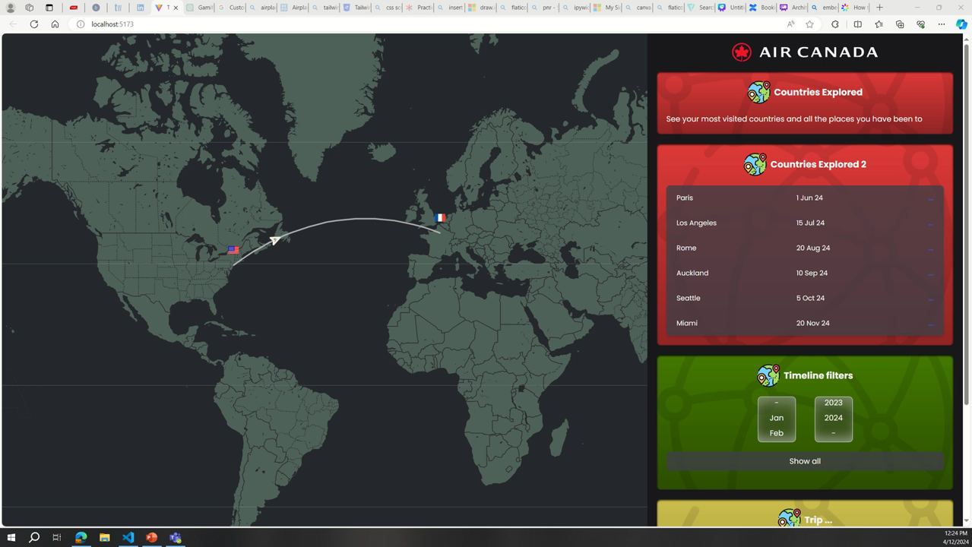

Slide 8
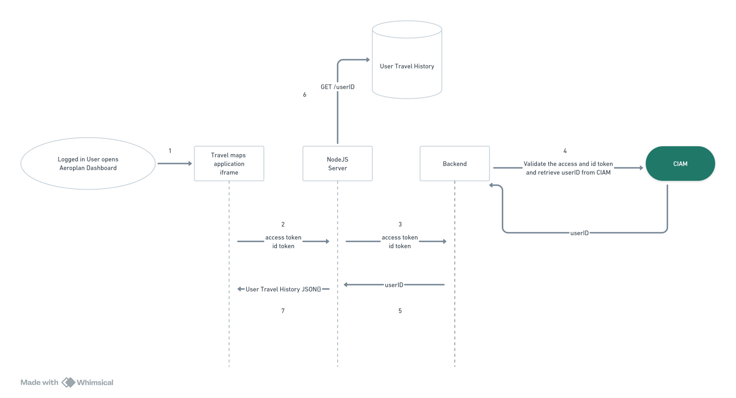
Data Retrieval Flow

Slide 9
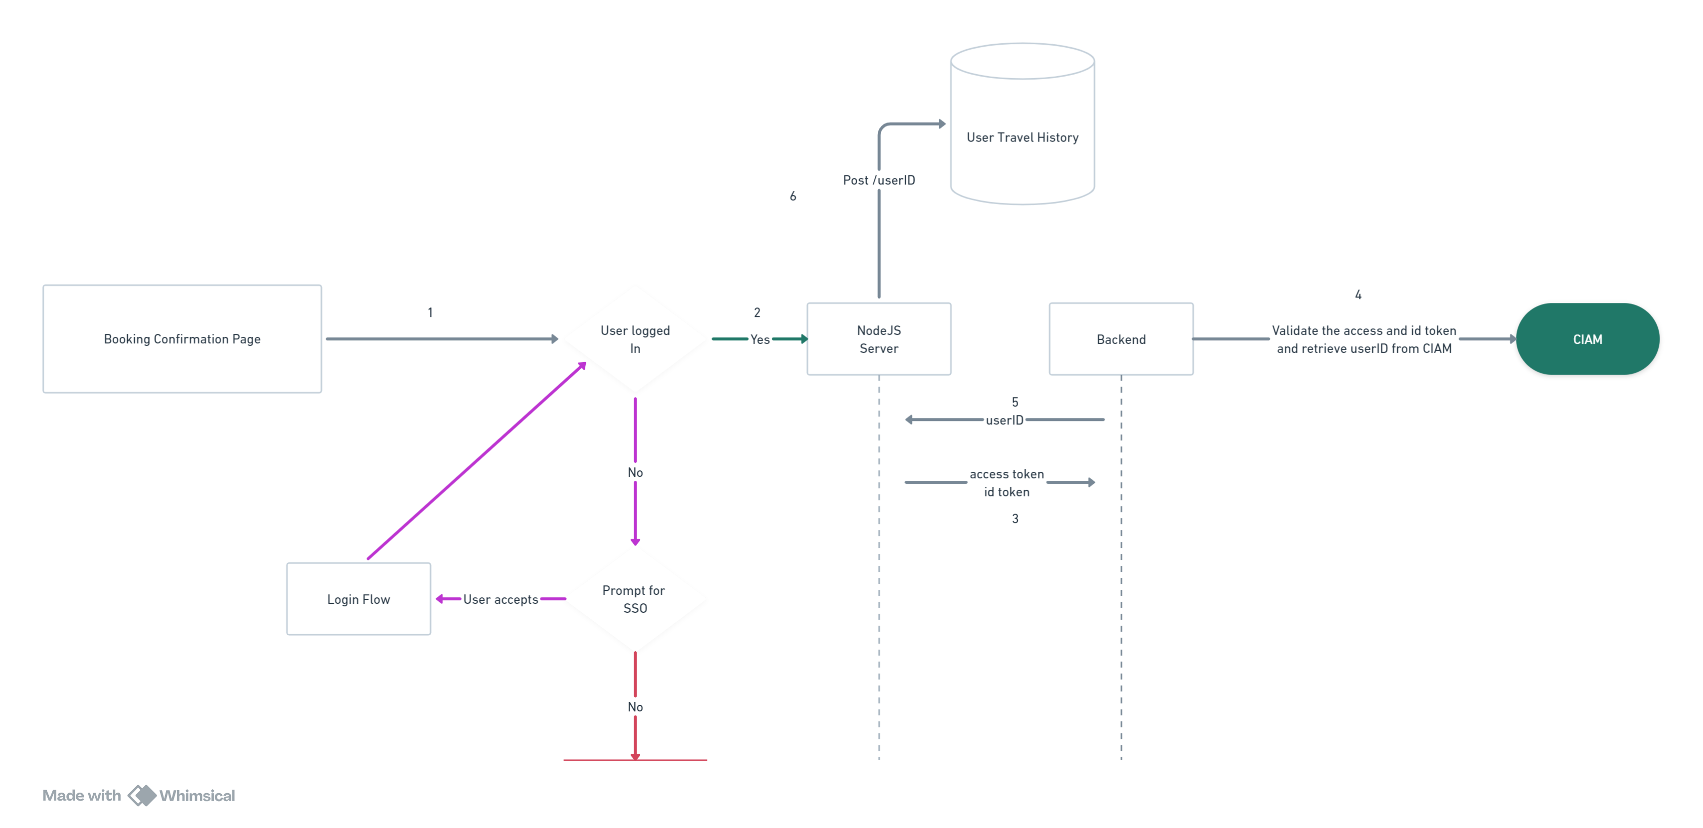
Data Ingestion Flow

Slide 10

User
Avatars

Slide 11
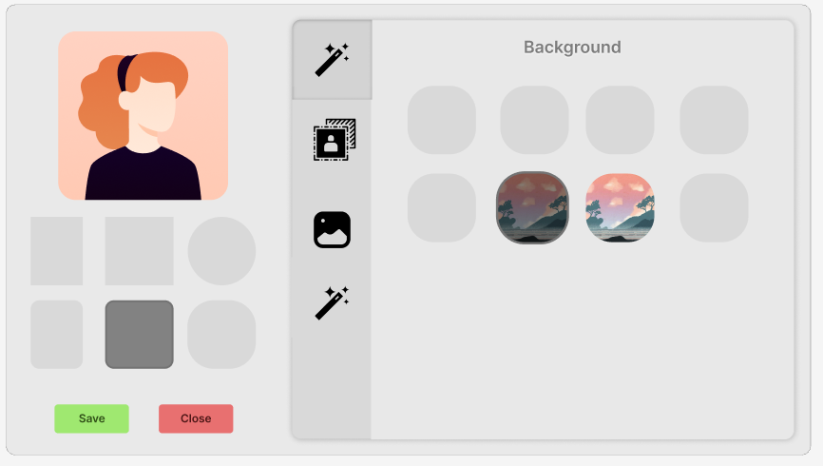

Slide 12
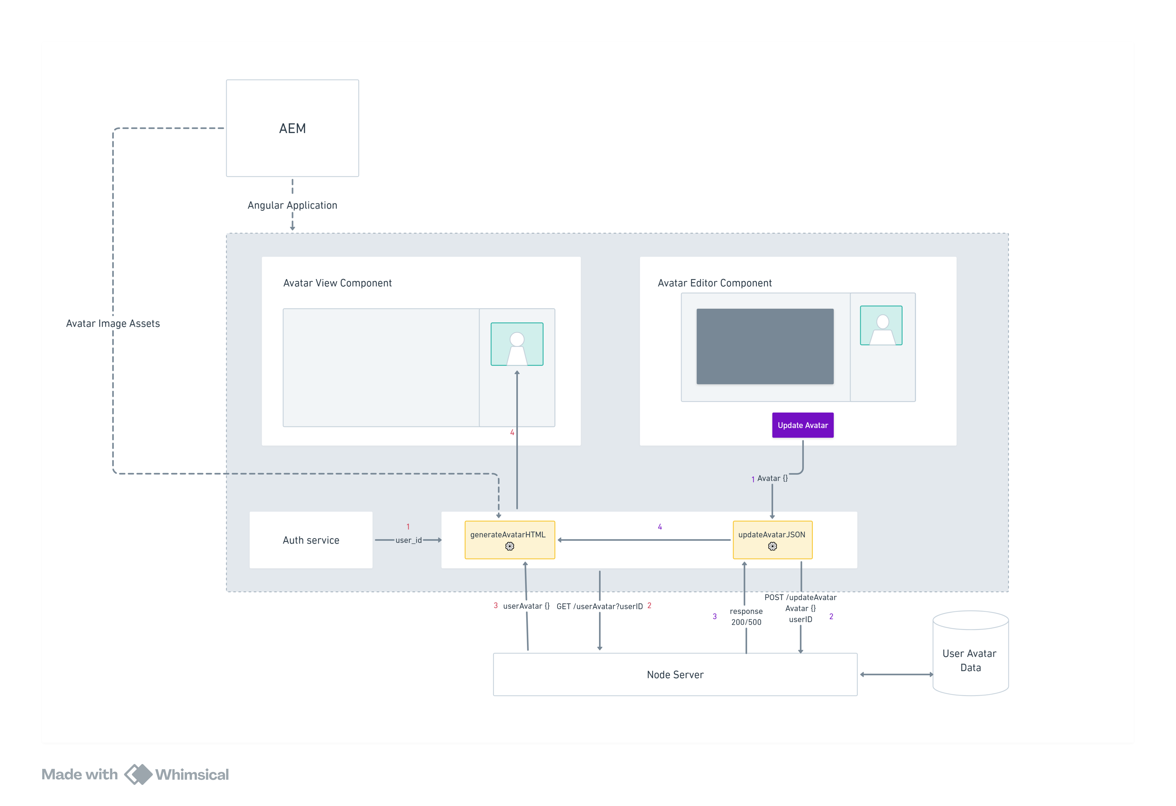

Slide 13

Travel Cards

Slide 14
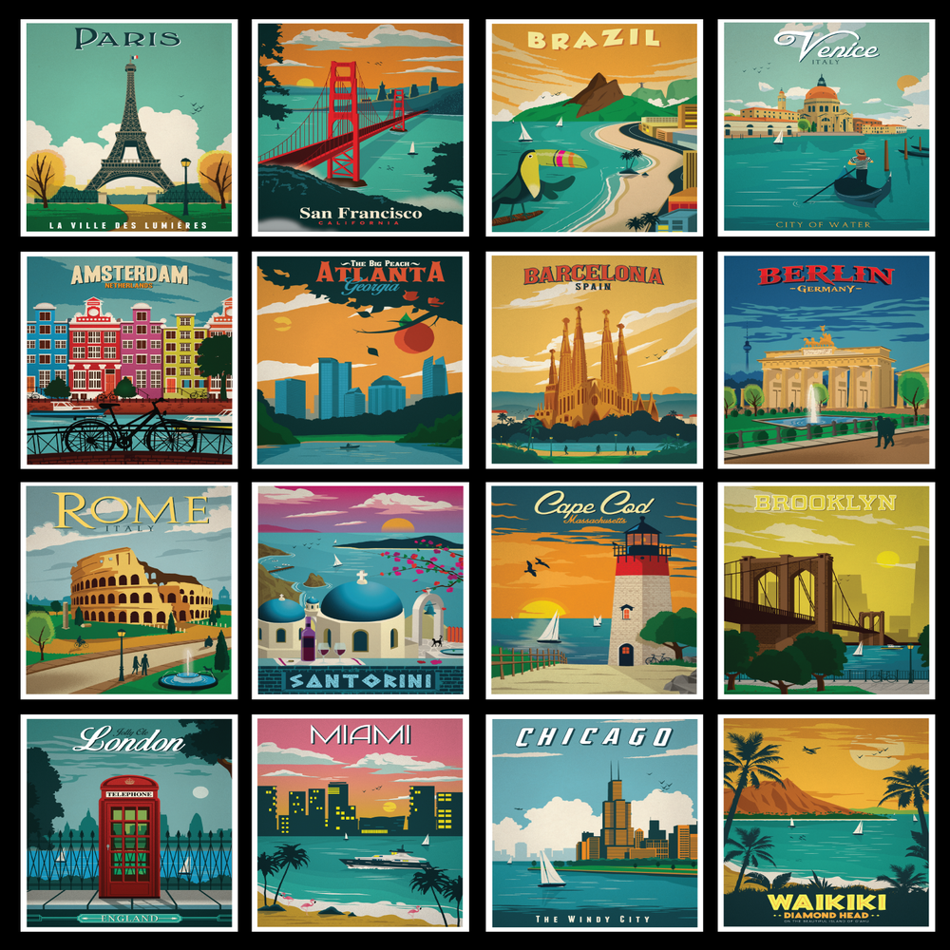

Slide 15
Challenges Faced
Learning Google maps API and tackling the issue of API keys
Integrating the web component in existing application
Tackling the authorization flow for embedded iframe
Learning AEM
Integrating Amadeus Internal APIs

Slide 16










Authorization using JWTs
HTML, CSS, JS
Web Components
Angular
LEARNINGS
Google Maps API
Figma
Express Mongo
Integration
AEM
Notes:
Google API
Web components
Angular
Authorization using JWT(Conceptual)
HTML
CSS
JS
Tailwind CSS
Figma – created your own mockups
Express mongo
Make node servers scalable

Slide 17
Feedback about the Project Semester and Faculty Visit
Exposure to industry standards
Working on complex projects
Learning about the complete development to deployment pipeline
Personality development
Networking opportunities with great people having great ideas
Strengthen Institute Industry Relations

Slide 18
Video Link
Video Link🔗
https://drive.google.com/drive/folders/12kAnJfcmxErDmKqaq3eQmy8PDmhixHrR?usp=sharing

Slide 19


